Slide 1
Components of Computer
Data Representation and
AI
Dr. Zahid Halim

Slide 2
Parts of a Computer
There are two main parts of computers, hardware and software
  Hardware is all of the parts of the computer you can see ( ? ) and touch. E.g.,
    Monitor, Keyboard, Processor, Memory, Circuits, Cables etc
  Software refers to parts of the computer which do not have a material form. E.g.,
    Data, Programs, Protocols etc

Slide 3
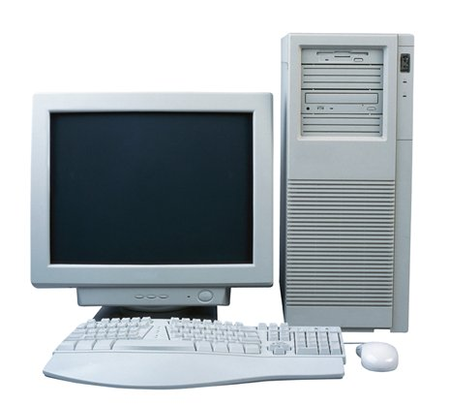
Computer :
An External Look
Casing [with components inside]
  Next slide
Monitor
  Lets the user see how the computer is
  responding to their command
Keyboard
  For entering text commands
Mouse
  Point-and-Click interface for
  interacting with graphical
  environment

Slide 4
Computer:
Internal Components (-1-)
Inside the casing, we have a built-in power supply along with:
  Motherboard
    It is the central printed circuit board (PCB) where the core components of your computer reside
      provides slots to host microprocessor, memory, driver controllers, graphics card, modem, network card etc
      also provides electrical connections by which these hosted components communicate
  Hard Disk Drive
    Permanent storage for data and programs. Also, normally, your operating system is installed here.
  CD-ROM / DVD Player

Slide 5
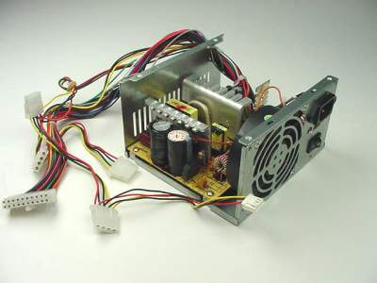
Computer:
Internal Components (-2-)
Power Supply

Slide 6
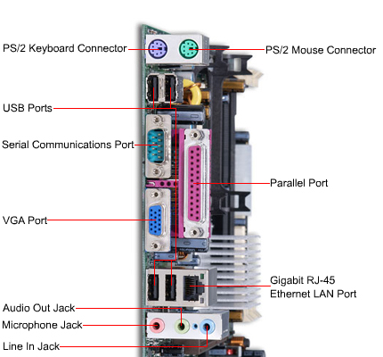
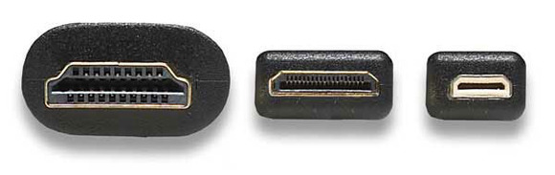
Computer:
Internal Components (-3-)
Motherboard:
Connectors & Ports
HDMI (High-Definition Multimedia Interface) is a compact audio/video interface for transferring uncompressed video data and compressed/uncompressed digital audio data from a HDMI-compliant device to a compatible computer monitor, video projector etc.
RJ=Registered Jack

Slide 7
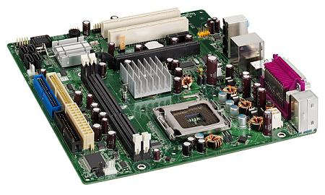
Computer:
Internal Components (-3-)
Peripheral Component Interconnect
accelerated graphics port
PCI Slot
[sound, network, modem]
AGP Slot [Graphics]
Integrated Drive Electronics
Advanced Technology Attachment
IDE / ATA Connector
[hard disk, CD-ROM]
DRAM Memory Slot
Power Connector
Slot for Microprocessor
Motherboard: Sockets & Slots

Slide 8
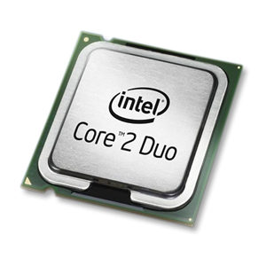
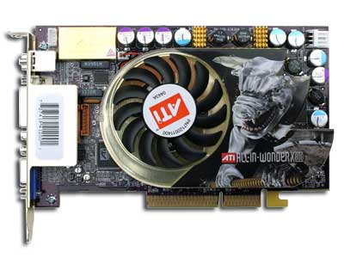
Computer:
Internal Components (-4-)
Microprocessor
Graphics Card

Slide 9
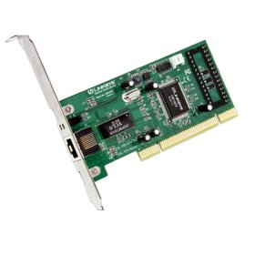
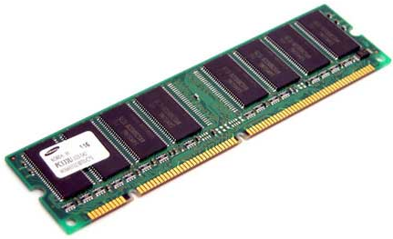
Computer:
Internal Components (-5-)
RAM
Network Card

Slide 10
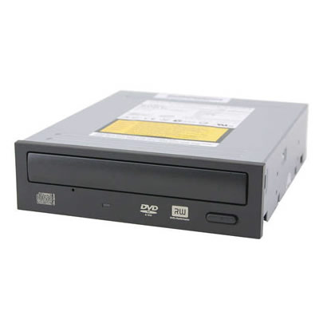
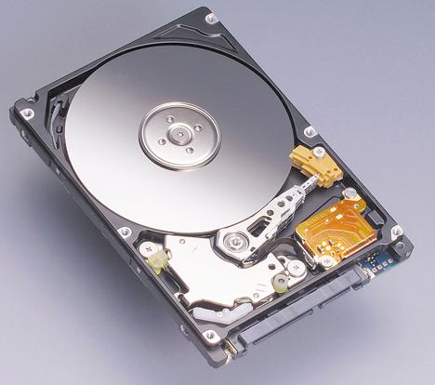
Computer:
Internal Components (-6-)
Hard Disk Drive
DVD RW

Slide 11
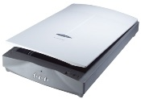
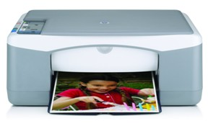
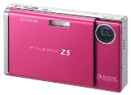
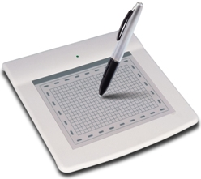
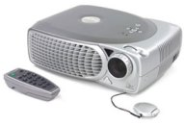
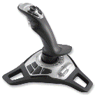
Computer:
Peripherals
A peripheral device is an equipment that might be added to a computer system to enhance its functionality
  Printer
  Digital camera
  Scanner
  Projector
  Joystick
  Graphics tablet

Slide 12
Data Representation

Slide 13
Data Representation
Modern computers are digital devices
  A digital device works with discrete data, such as the digits 1 and 0
  An analog device works with continuous data
Just as a standard light switch is a simpler technology than a dimmer, so is digital when compared to analog
digital
analog

Slide 14
Number System
We use decimal number system [base 10] when representing numeric values in our daily life
  E.g., consider the number 123
    123 = 100 + 20 + 3 = 1*10² + 2 * 10¹ + 3*10⁰
Most modern computer systems do not use the decimal system to represent numeric values.
  Instead, they use a binary numbering system [base 2]
    Consisting of only two digits: 1 and 0
    Uses powers of 2 rather than 10

Slide 15
Conversions
Conversion from binary to decimal:
  (1011)₂ = 1*2³ + 0*2² + 1*2¹ + 1*2⁰ = (11)₁₀
Conversion from decimal to binary:
2
125
2
62 – 1
2
16
2
31 – 0
2
8 – 0
2
15 – 1
(125)₁₀
= (1111101)₂
2
4 – 0
(16)₁₀
= (10000)₂
2
7 – 1
2
2 – 0
2
3 – 1
2
1 – 0
2
1 – 1

Slide 16
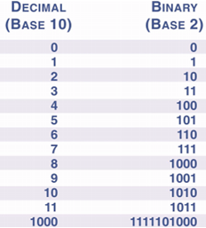
Representing
Non-Numeric Data
Some decimal values & their binary equivalents ➔
In addition to numeric data, computers also
manipulate character data
    numbers, symbols, numerals that are not used
    in arithmetic operations
  To represent them, codes have been developed
  that specify binary equivalent for each character
    ASCII – 7 bits [Example table given →]
    Unicode – 16 bits
Sounds and pictures must be transformed
into a format the computer can understand
  A computer must digitize colors, notes, and
  instrument sounds into 1s and 0s
Char | Decimal | Binary
A | 65 | 100 0001
B | 66 | 100 0010
0 | 48 | 011 0000
1 | 49 | 011 0001
$ | 36 | 010 0100

Slide 17
Quantifying Bits and Bytes
A bit is one binary digit (b):
  can have value either 0 or 1
A byte is 8 bits (B)
  0010 0100
Kilo- means a 1000; Mega- means million; Giga -means billion
  Kilobit (Kb) is 1,024 bits
  Kilobyte (KB) is 1,024 bytes
  Megabyte (MB) is 1,048,576 bytes
  Gigabyte (GB) is 1,073,741,824 bytes
Bits take the form of electrical pulses that can travel over circuits
  Almost the same way as electricity flows over a wire when you turn on a light switch

Slide 18
What is Intelligence?
Ability to interact with world
Ability to PERCEIVE and ACT
Reasoning, Planning
Make decisions
Websters: “Capacity to learn and Understand Problems”
LEARNING and ADAPTATION: also major thrust at Microsoft Research!
Notes:
Ability to interact with world
Ability to PERCEIVE and ACT
Reasoning, Planning
Make decisions
Websters: “Capacity to learn and Understand Problems”
LEARNING and ADAPTATION: also major thrust at Microsoft Research!

Slide 19
What is Artificial Intelligence?
Model HUMAN COGNITION
  Psychological level – errors and all
  Neural level
Optimize PERFORMANCE on specific tasks – examples
  Games
  Expert systems – manufacturing
  Speech understanding, ETC
  The turing test…
Notes:
Model HUMAN COGNITION
Psychological level – errors and all
Neural level
Optimize PERFORMANCE on specific tasks – examples
Games
Expert systems – manufacturing
Speech understanding, ETC
The turing test…

Slide 20
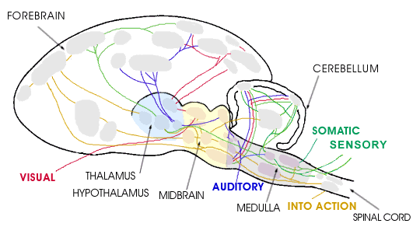
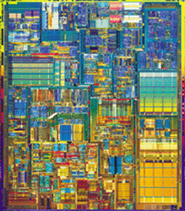
Hardware
10¹¹ neurons
10¹⁴ synapses
cycle time: 10⁻³ sec
10⁷ transistors
10¹⁰ bits of RAM
cycle time: 10⁻⁹ sec
Notes:
Far fewer interconnections!
Much faster update!

Slide 21
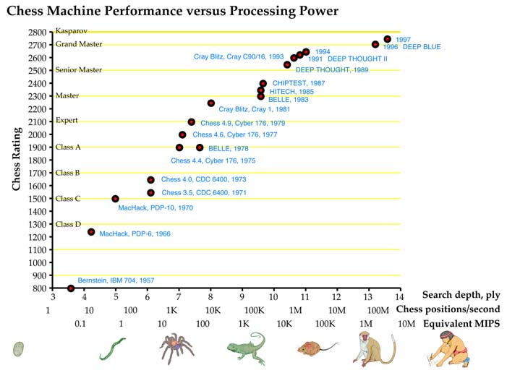
Computer vs. Brain
Computers have far to go to match human strengths, and our estimates will depend on analogy and extrapolation.
Thirty years of computer vision reveals that 1 MIPS can extract simple features from real-time imagery–tracking a white line or a white spot on a mottled background.
10 MIPS can follow complex gray-scale patches–as smart bombs, cruise missiles and early self-driving vans attest.
100 MIPS can follow moderately unpredictable features like roads
Notes:
Computers have far to go to match human strengths, and our estimates will depend on analogy and extrapolation. Thirty years of computer vision reveals that 1 MIPS can extract simple features from real-time imagery–tracking a white line or a white spot on a mottled background. 10 MIPS can follow complex gray-scale patches–as smart bombs, cruise missiles and early self-driving vans attest. 100 MIPS can follow moderately unpredictable features like roads 1,000 MIPS will be adequate for coarse-grained three-dimensional spatial awareness–illustrated by 1,500 cubic centimeter human brain is about 100,000 times as large as the retina, suggesting that matching overall human behavior will take about 100 million MIPS of computer power. several mid-resolution stereoscopic vision programs, Deep Blue, the chess machine that bested world chess champion Garry Kasparov in 1997, used specialized chips to process chess moves at a the speed equivalent to a 3 million MIPS universal computer

Slide 22
Conclusion
  In near future we can have computers with as many processing elements as our brain, but:
  far fewer interconnections (wires or synapses)
  much faster updates.
Fundamentally different hardware may
require fundamentally different algorithms!
  Very much an open question.
  Neural net research.

Slide 23

Classical AI
The principles of intelligence are separate from any hardware / software / wetware implementation
Look for these principles by studying how to perform tasks that require intelligence
Can we rely on simple tasks? (e.g., 8-puzzle, tic tac toe)

Slide 24
Success Story: Medical Expert Systems
Mycin (1980)
  Expert level performance in diagnosis of blood infections
Today: 1,000’s of systems
  Everything from diagnosing cancer to designing dentures
  Often outperform doctors in clinical trials
  Major hurdle today – non-expert part – doctor/machine interaction

Slide 25
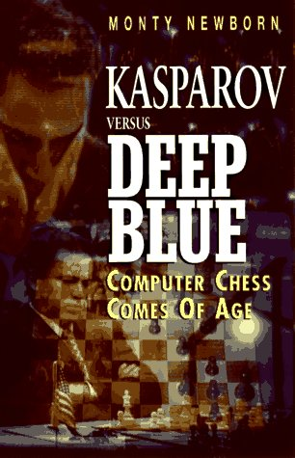
Success Story:
Chess
  I could feel – I could smell – a new kind of intelligence across the table
  - Kasparov
Examines 5 billion positions / second
Intelligent behavior emerges from brute-force search

Slide 26
Autonomous Systems
In the 1990’s there was a growing concern that work in classical AI ignored crucial scientific questions:
  How do we integrate the components of intelligence (e.g. learning & planning)?
  How does perception interact with reasoning?
  How does the demand for real-time performance in a complex, changing environment affect the architecture of intelligence?

Slide 27

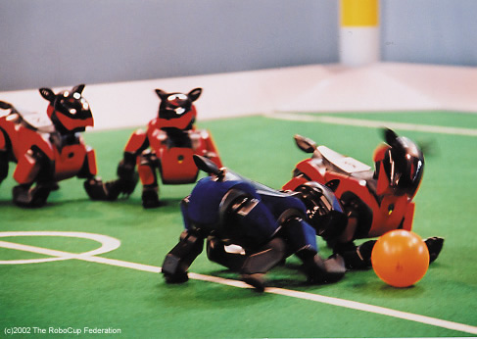
Provide a standard problem where a wide range of technologies can be integrated and examined
By 2050, develop a team of fully autonomous humanoid robots that can win against the human world champion team in soccer.

Slide 28
Software Robots (softbots)
Softbots: ‘intelligent’ program that uses software tools on a person’s behalf.
Sensors = LS, Google, etc.
Effectors = RM, ftp, Amazon.com
Software: not physical but not simulated.
Active: not a help system (softbot safety!)

Slide 29
Key Hard Problem for AI
Today’s successful AI systems
  operate in well-defined domains
  employ narrow, specialize knowledge
Commonsense Knowledge
  needed to operate in messy, complex, open-ended worlds
    Your kitchen vs. GM factory floor
  understand unconstrained Natural Language

Slide 30
Role of Knowledge in Natural Language Understanding
Speech Recognition
  “word spotting” feasible today
  continuous speech – rapid progress
  turns out that “low level” signal not as ambiguous as we once thought
Translation / Understanding
  very limited progress
  The spirit is willing but the flesh is weak. (English)
  The vodka is good but the meat is rotten. (Russian)
Notes:
automatic translation only really successful in
very limited domains – eg weather reports
as a tool for human editors to extensively revise

Slide 31



The Turing Test
1950 – Alan Turing devised a test for intelligence called the Imitation Game
  Ask questions of two entities, receive answers from both
  If you can’t tell which of the entities is human and which is a computer program, then you are fooled and we should therefore consider the computer to be intelligent
Questions
Answers
Answers
Modern tests needs today
Which is the person?
Which is the computer?

Slide 32
Why “Learn” ?
Machine learning is programming computers to optimize a performance criterion using example data or past experience.
There is no need to “learn” to calculate payroll
Learning is used when:
  Human expertise does not exist (navigating on Mars),
  Humans are unable to explain their expertise (speech recognition)
  Solution changes in time (routing on a computer network)
  Solution needs to be adapted to particular cases (user biometrics)

Slide 33
What We Talk About When We Talk About“Learning”
Learning general models from a data of particular examples
Data is cheap and abundant (data warehouses, data marts); knowledge is expensive and scarce.
Example in retail: Customer transactions to consumer behavior:
  People who bought “Da Vinci Code” also bought “The Five People You Meet in Heaven” (www.amazon.com)
Build a model that is a good and useful approximation to the data.

Slide 34
Data Mining
Retail: Market basket analysis, Customer relationship management (CRM)
Finance: Credit scoring, fraud detection
Manufacturing: Optimization, troubleshooting
Medicine: Medical diagnosis
Telecommunications: Quality of service optimization
Bioinformatics: Motifs, alignment
Web mining: Search engines
...

Slide 35
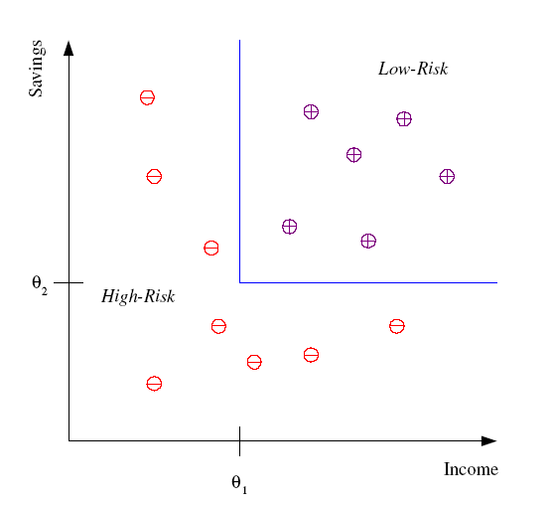
Classification
Example: Credit scoring
Differentiating between low-risk and high-risk customers from their income and savings
Discriminant: IF income > θ₁ AND savings > θ₂
THEN low-risk ELSE high-risk

Slide 36
Classification: Applications
Aka Pattern recognition
Face recognition: Pose, lighting, occlusion (glasses, beard), make-up, hair style
Character recognition: Different handwriting styles.
Speech recognition: Temporal dependency.
  Use of a dictionary or the syntax of the language.
  Sensor fusion: Combine multiple modalities; eg, visual (lip image) and acoustic for speech
Medical diagnosis: From symptoms to illnesses
...

Slide 37








Face Recognition
Training examples of a person
Test images
AT&T Laboratories, Cambridge UK
http://www.uk.research.att.com/facedatabase.html

Slide 38
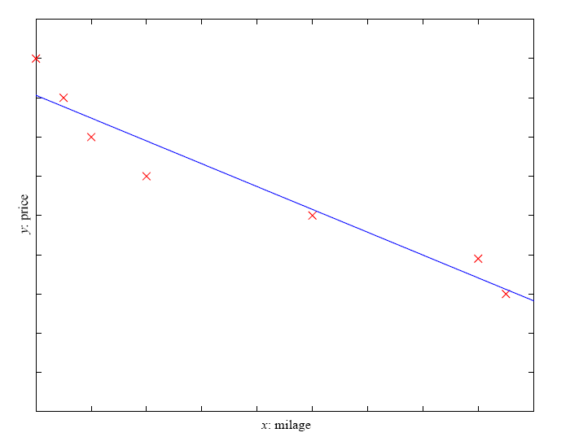
Regression
Example: Price of a used car
x : car attributes
y : price
y = g (x | θ )
g ( ) model,
θ parameters
y = wx+w₀

Slide 39
Regression Applications
Navigating a car: Angle of the steering wheel (CMU NavLab)
Kinematics of a robot arm
(x,y)
α₁= g₁(x,y)
α₂= g₂(x,y)
α₂
α₁
Response surface design

Slide 40
Supervised Learning: Uses
Prediction of future cases: Use the rule to predict the output for future inputs
Knowledge extraction: The rule is easy to understand
Compression: The rule is simpler than the data it explains
Outlier detection: Exceptions that are not covered by the rule, e.g., fraud

Slide 41
Unsupervised Learning
Learning “what normally happens”
No output
Clustering: Grouping similar instances
Example applications
  Customer segmentation in CRM
  Image compression: Color quantization
  Bioinformatics: Learning motifs

Slide 42
Reinforcement Learning
Learning a policy: A sequence of outputs
No supervised output but delayed reward
Credit assignment problem
Game playing
Robot in a maze
Multiple agents, partial observability, ...

